Slide 1
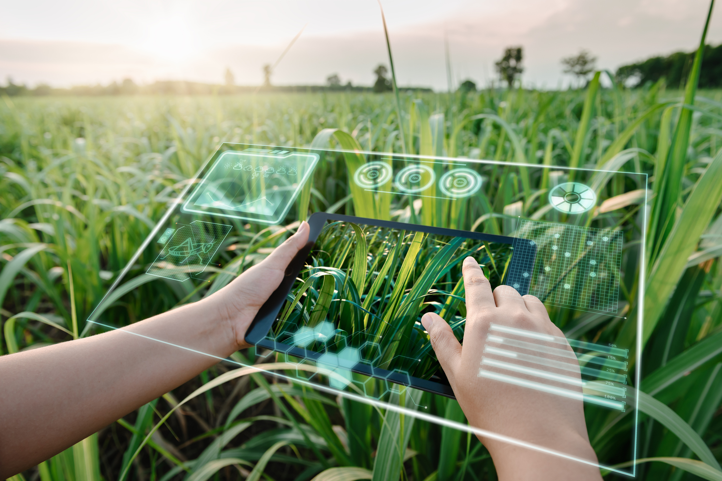
PROJECT 4 – GROUP 5
SMART FARMING POWERED BY AI
CASSIE, BARSHA, KRISTY, BARANI

Slide 2
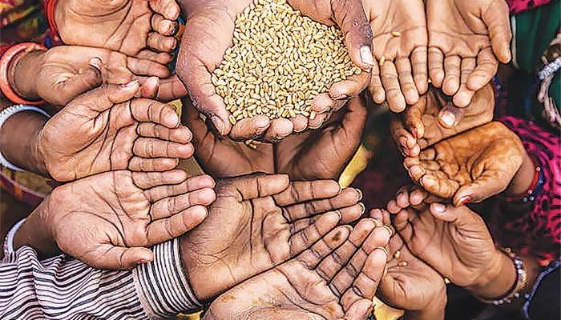
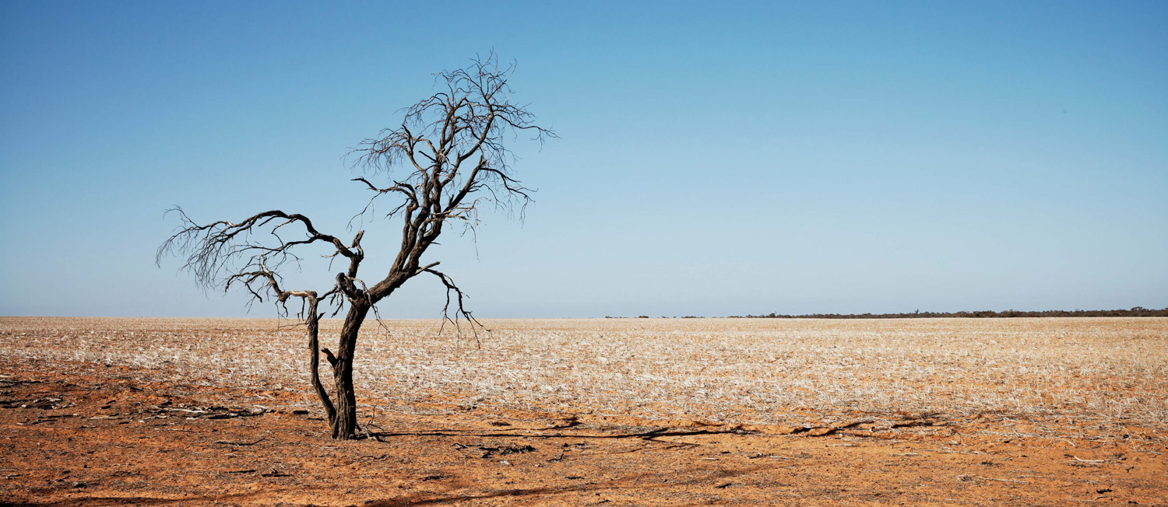
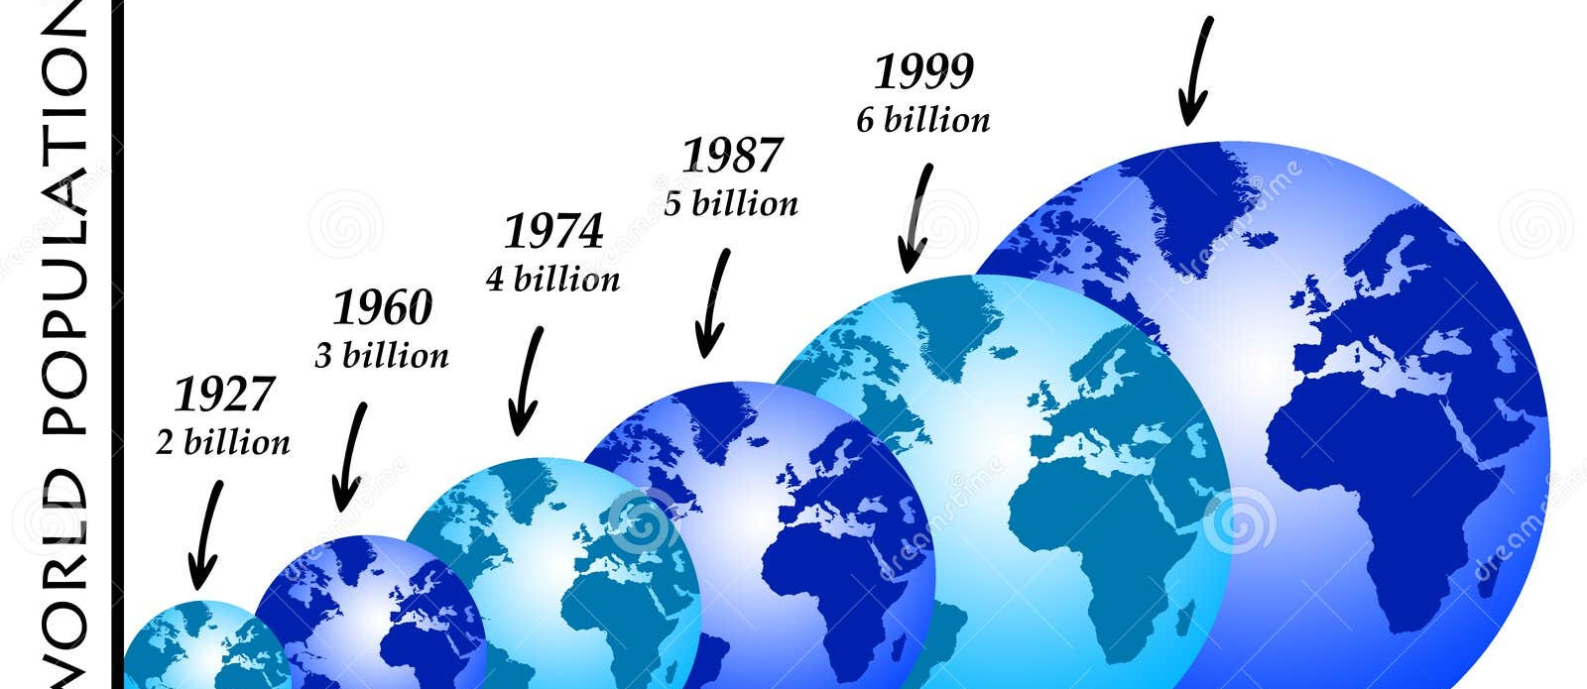
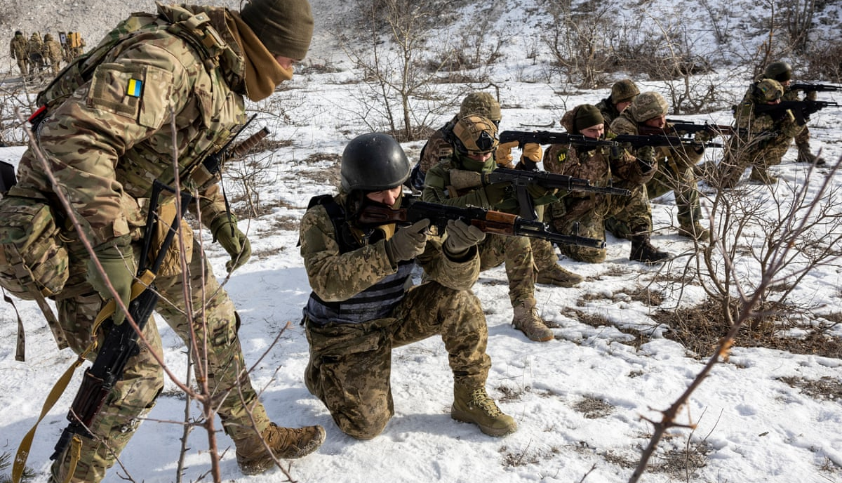
Notes:
Global Warming, Population Explosion, Food Crisis, Soil Health and Nutrient Management

Slide 3

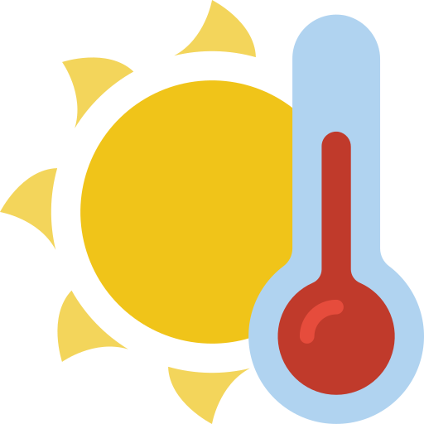
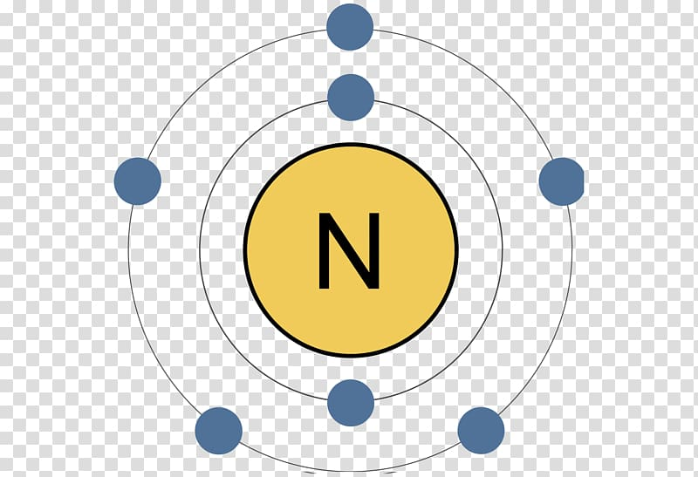
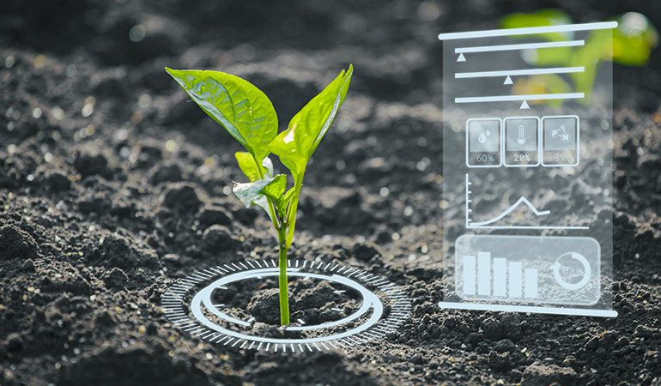

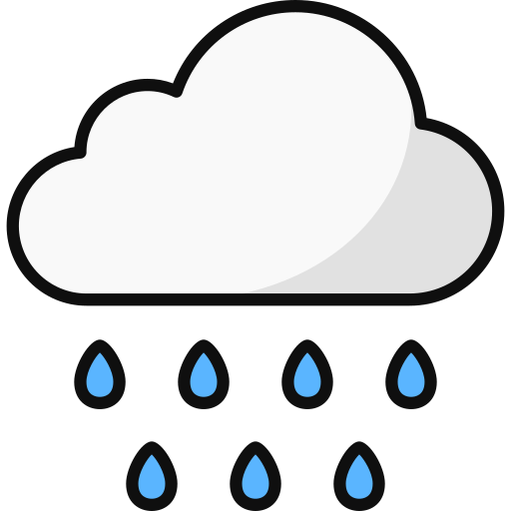

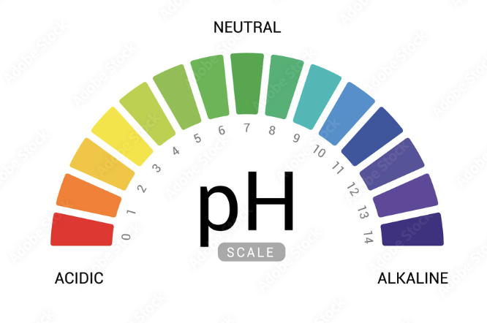

Which Crop Suitable?
Nitrogen
Temp ℃
Phosphorus
Potassium
Rainfall
Humidity

Slide 4
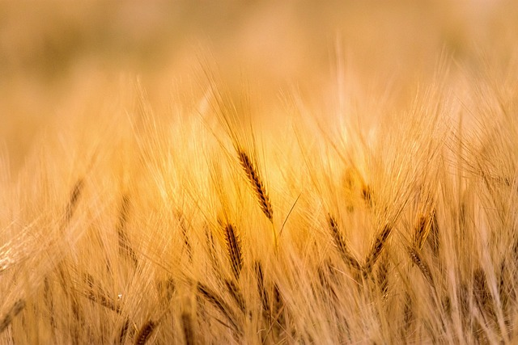
Agenda
PROJECT OBJECTIVE
APP DEMO
ABOUT DATA
DATA CLEANING & CLUSTURING
ML MODEL & ACCURACY
LIMITATIONS & FUTURE EXPANSIONS

Slide 5
Let’s demo the Smart Farming App…

Slide 6
About Data
22 Crop Types
100 Samples for Each Crop Type
7 Features: Temperature, pH, Humidity, Rainfall, Nitrogen(N), Phosphorus(P) & Potassium(K) in the soil
1 Target – What Crop to Grow ?
Data source : Kaggle.com

Slide 7




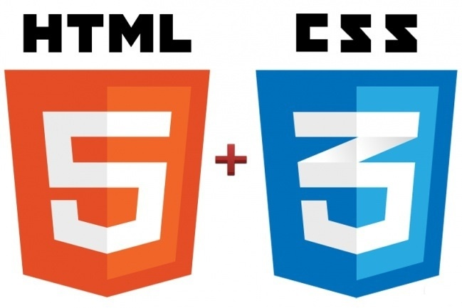
Tools

Slide 8
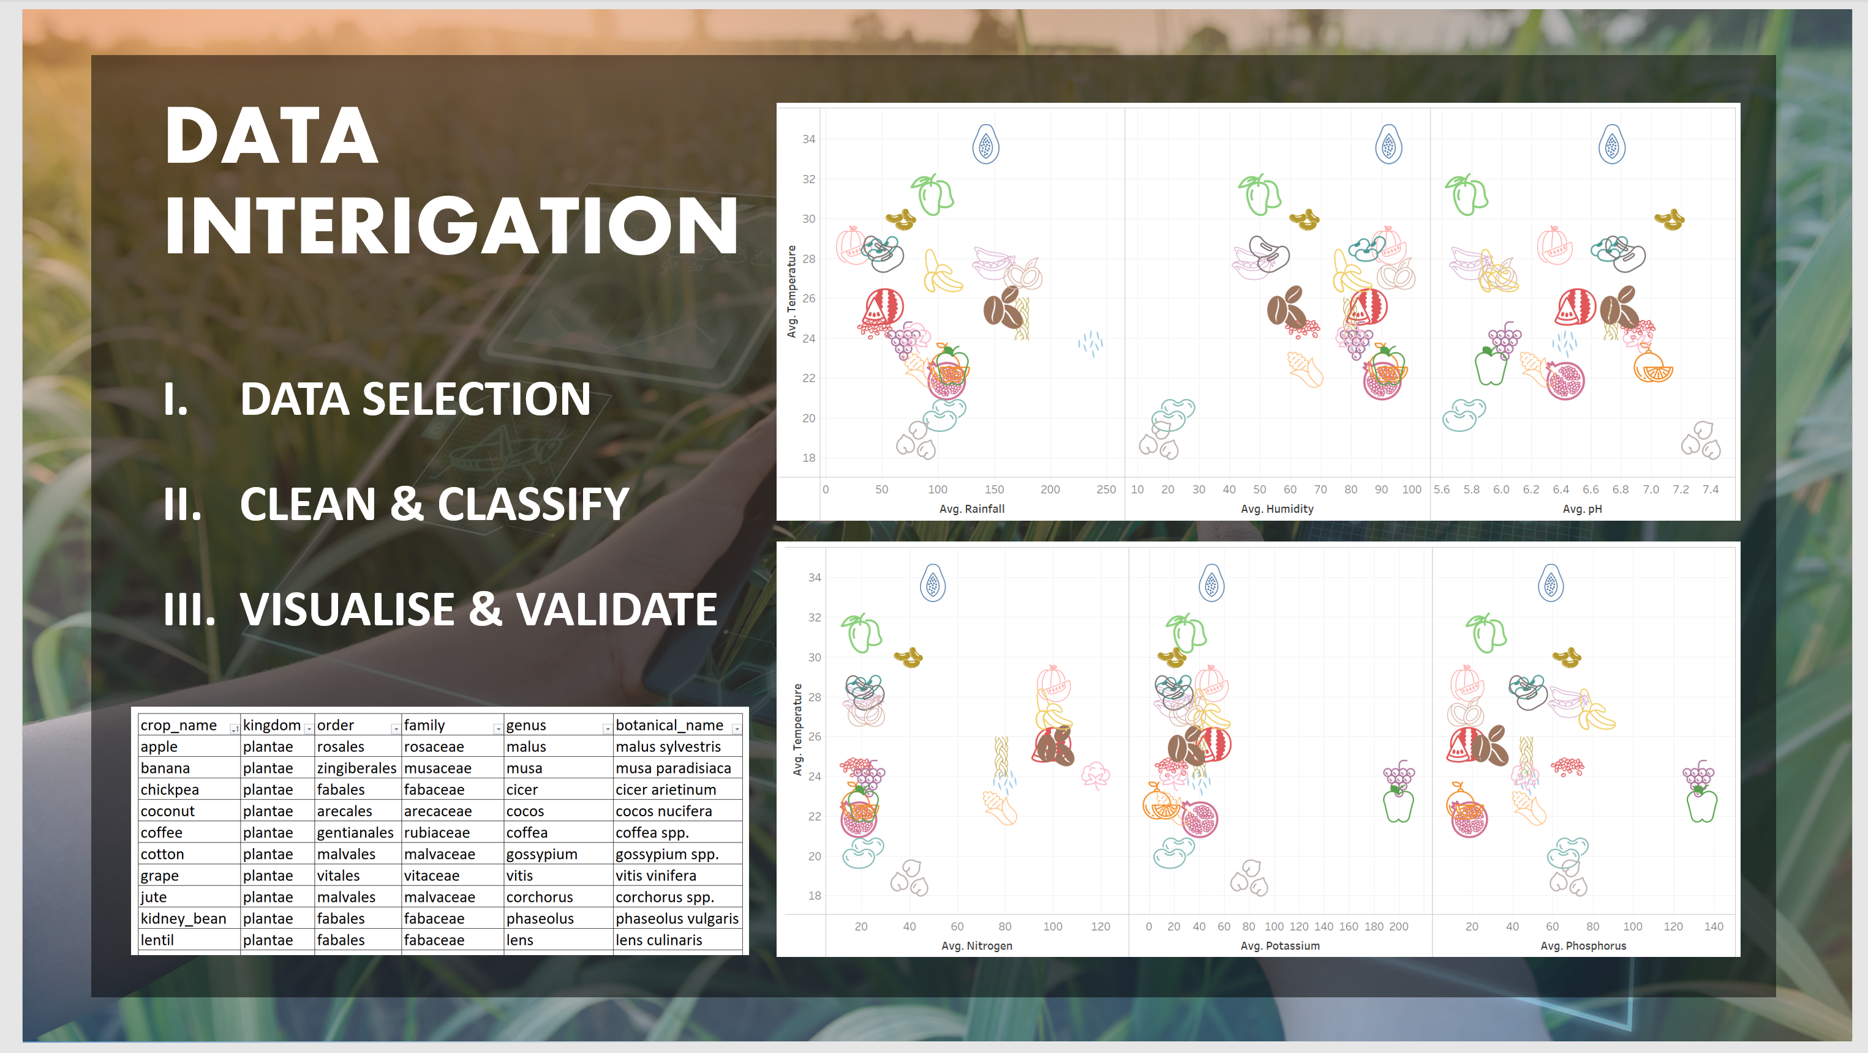

Slide 9
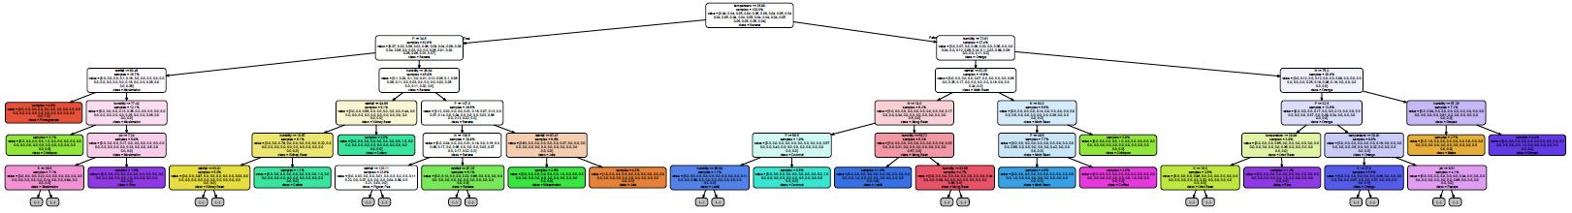
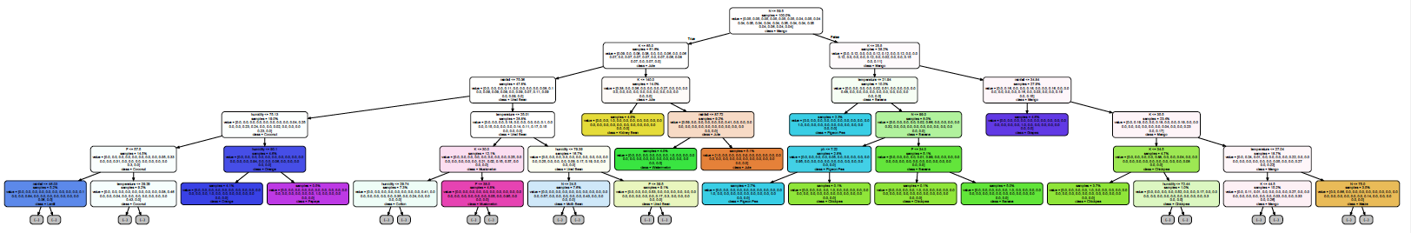
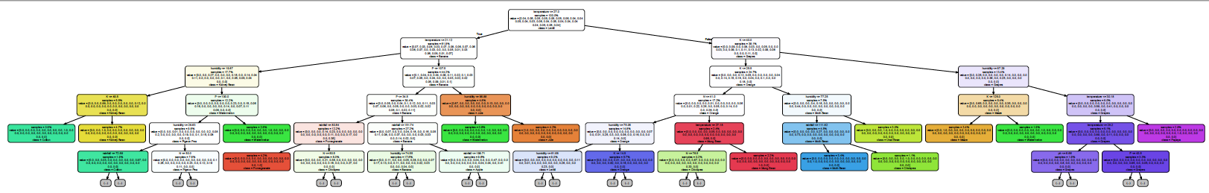
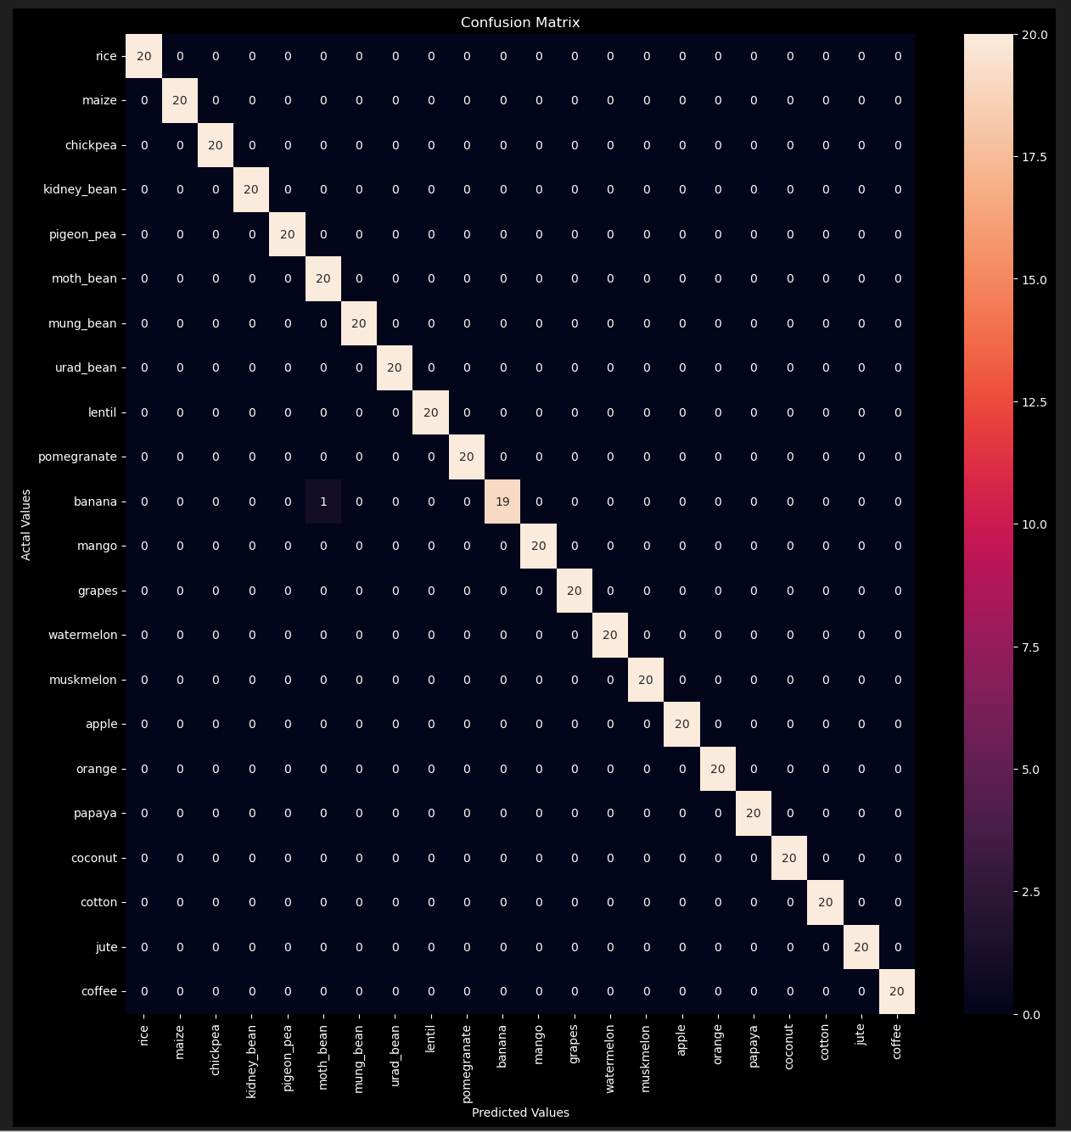
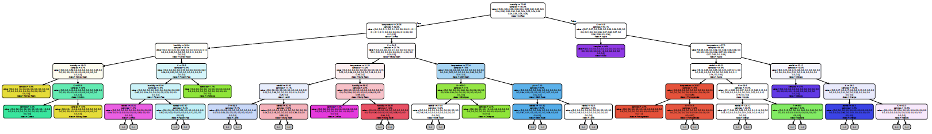
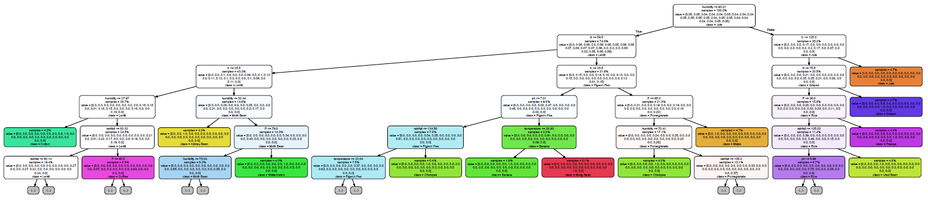
MODELS
SELECT, TRAIN & TEST
MEASURE, COMPARE & VALIDATE

Slide 10
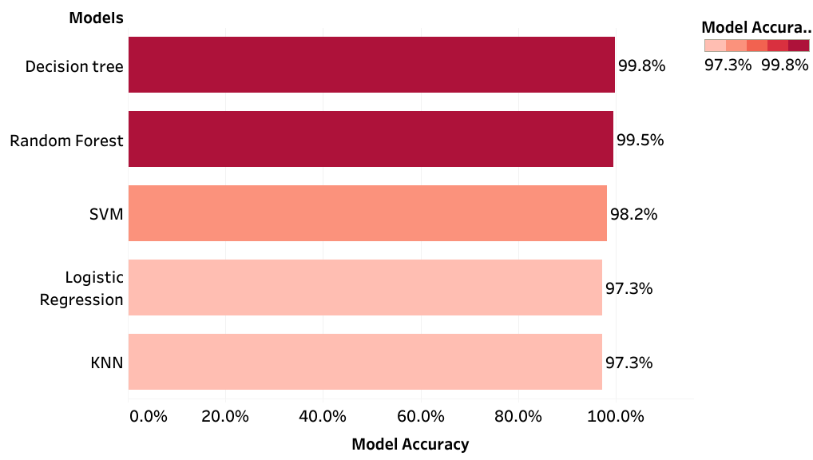
ML Models – Accuracy Score

Slide 11
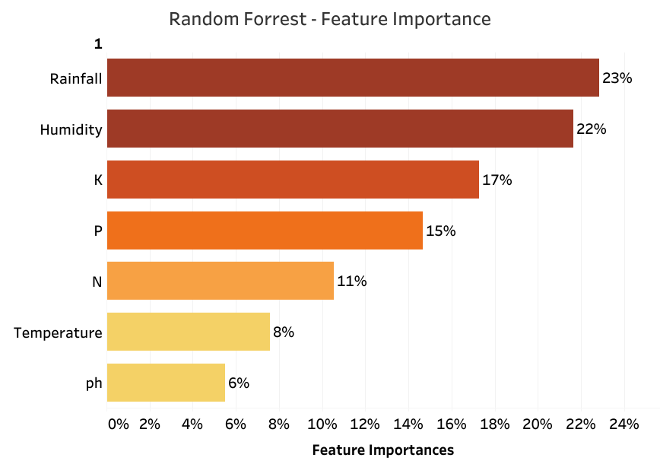
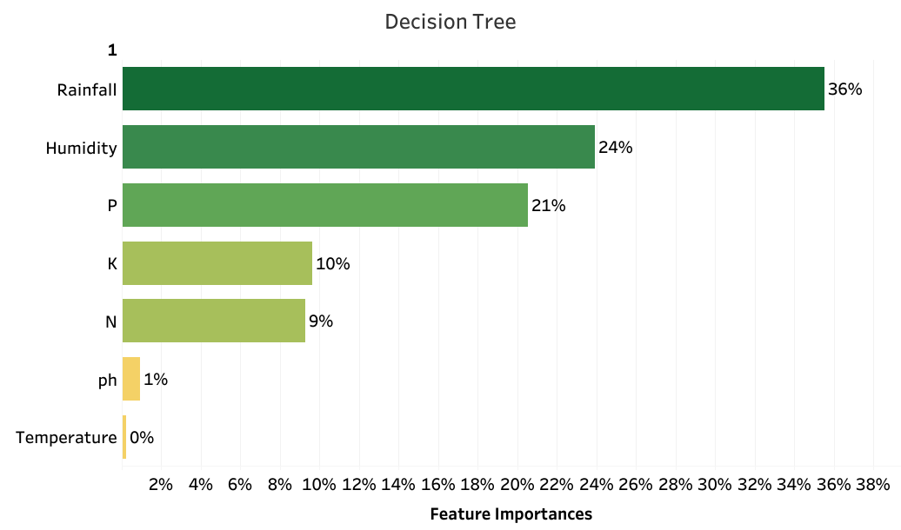
Why Random Forest ?
Random Forest Accuracy Score : 99.5%
Decision Tree Accuracy Score : 99.7%

Slide 12
Limitations
N, P, K, Rainfall, Temperature, pH & Humidity – NOT ENOUGH
External factors such as season, wind, sunlight per day, etc. - ADD VALUES.
Future Expansions
Crop Life Cycle Monitoring System – Monitors crop life from seeding to Harvest
Soil Fertility Monitoring System - To preserve & enrich Soil minerals

Slide 13
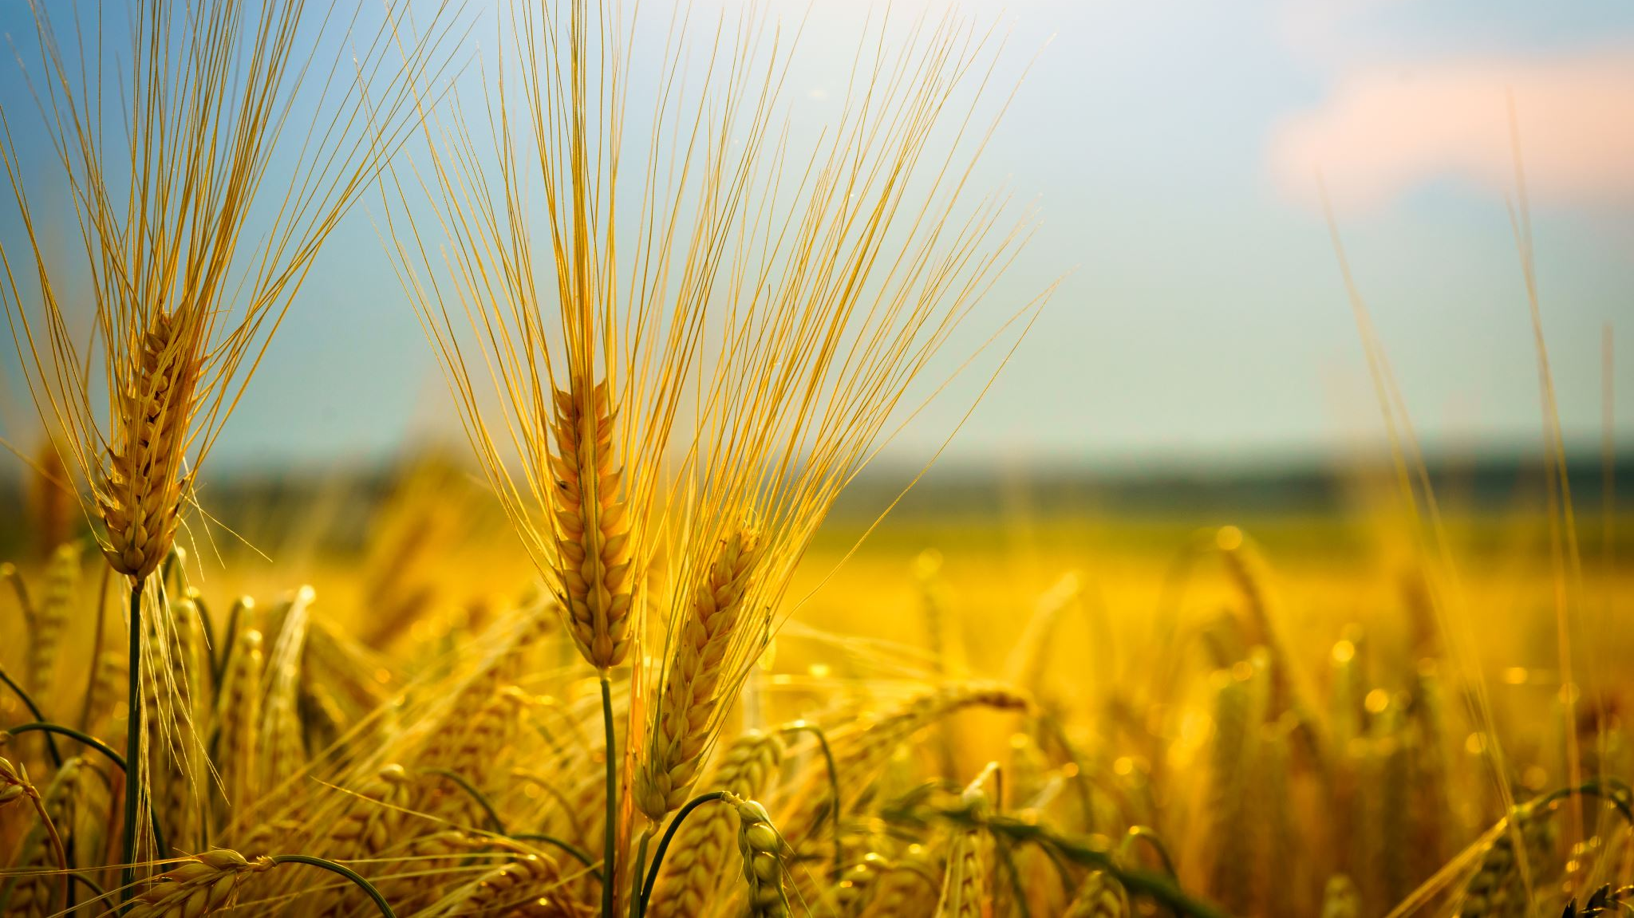
Thank You

